Slide 1

Smart Surveillance System
Group Members
Khalilullah (G.L) : 17CS59
Muhammad Hamza : 17CS103
Ajay Kumar : 17CS77
Supervisor: Dr Moazzam Jawaid

Slide 2
Agenda
Introduction
Problem Statement
Methodology
Results

Slide 3
Introduction
Smart surveillance system is iot based idea for face detection and recognition in surveillance cameras for advance security.
It detects human face and match with the loaded dataset of house members if any facial features doesn’t match then that will be called as stranger .
Owner will be notified with email and sms and through alarm

Slide 4
Problem statement
Ratio of theft and intruders has increased drastically in our country
Secondly traditional cameras lacks quick alert notifications incase any intruder get into the house
Camera with these features are very costly not every one can manage to buy

Slide 5
Methodology
We have used raspberry pi as our cpu to process our video streaming
Pi hd camera has been used for detecting facial features
Camera will record live video and incase any strange action happens it detects and using ip address it sent notification to owner mobile as well as it starts system alarm .

Slide 6
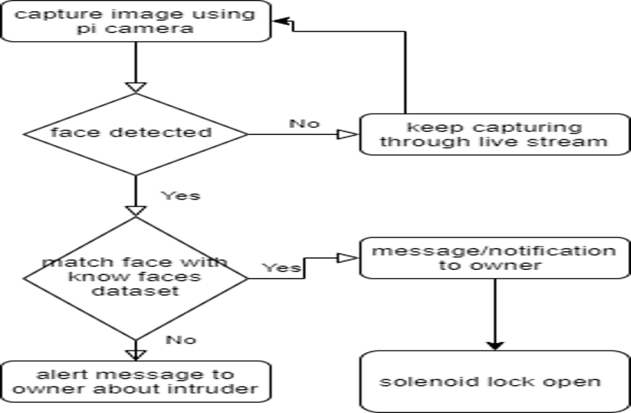
Methodology
Twillio app for alerting notification
For known and unknown persons
Raspicam app for live streaming

Slide 7
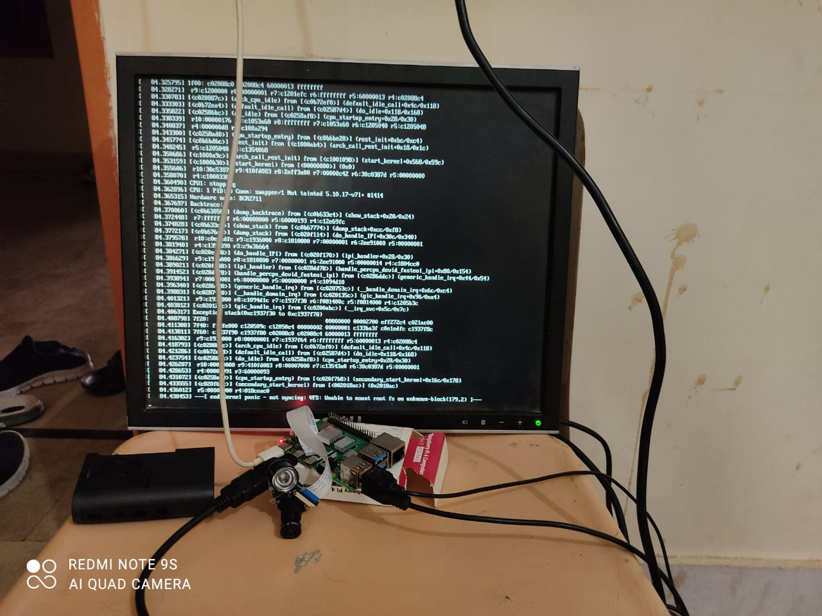

Slide 8
Results
We tested our system on various sample and in different conditions like in daylight and in night to check our classifier accuracy .in each sample we checked for detection of multiple no of faces and counted correct detection.
Along with face detection and recognition in day light , it also detect faces in night/dark time. This built in surveillance raspberry pi camera has also night vision facility , which helps the detection in dark.

Slide 9
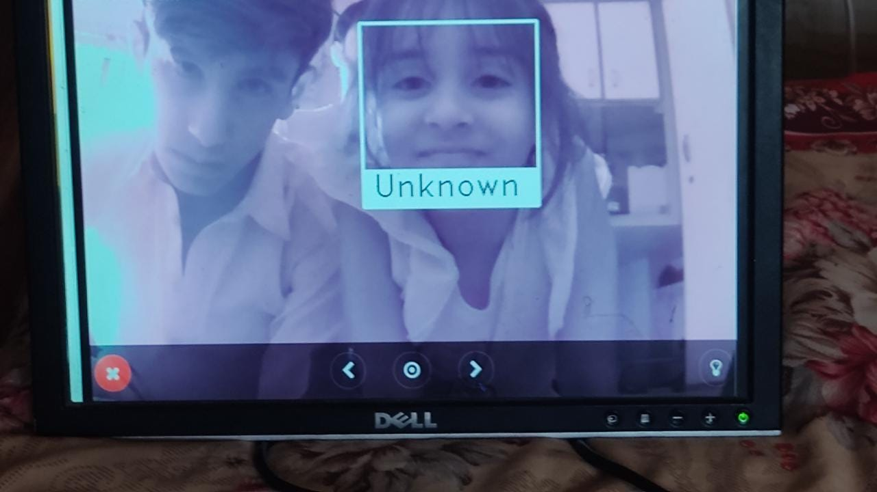
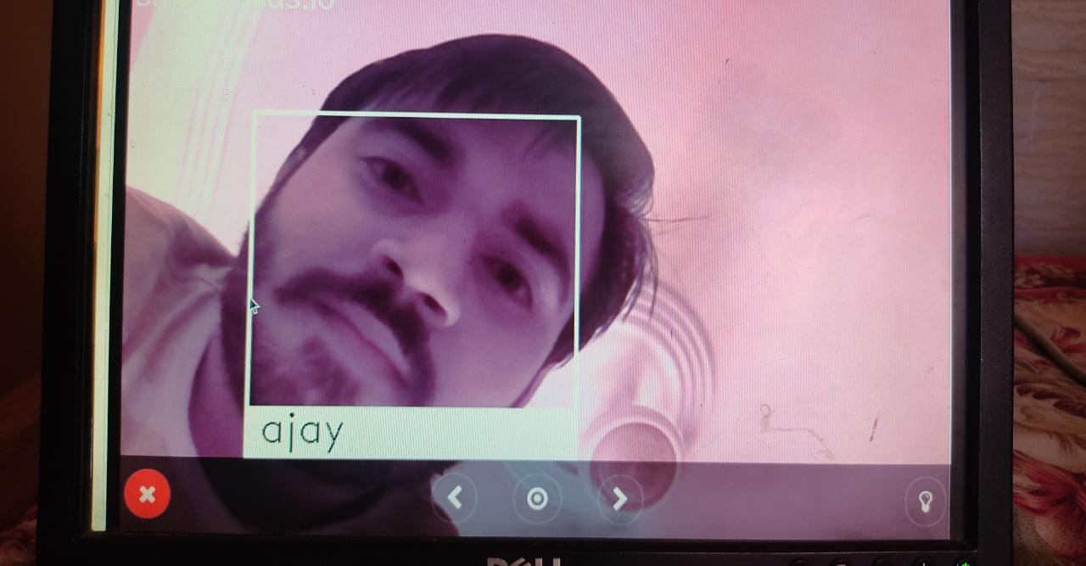
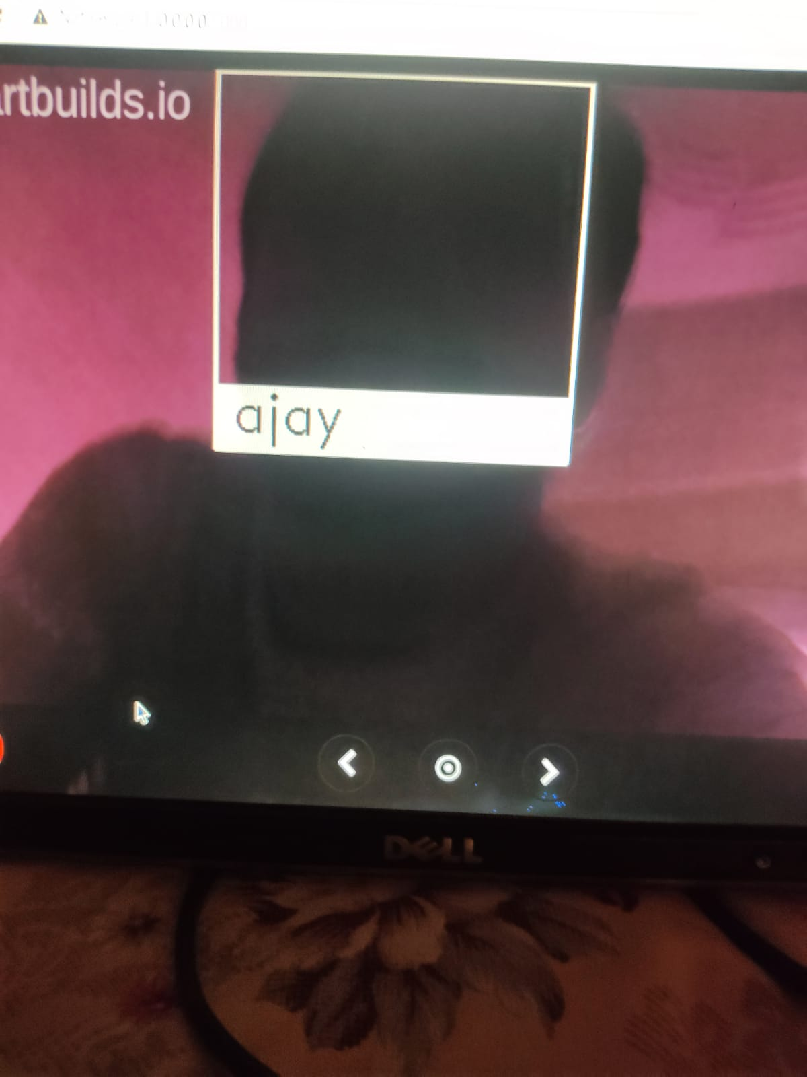
Results

Slide 10
Allah Hafiz

